Slide 1

Data Engineering Batch 1
PROJECT 2
Data Processing Pipeline
Akilesh K

Slide 2
Project Statement
Implement a serverless data processing pipeline where Azure Data Factory orchestrates data workflows, and Azure Databricks is used as a serverless processing engine for on-demand analytics and transformations.
Analysis
Set up an Azure Data Factory pipeline to facilitate data extraction to Data Lake storage.
Utilize Azure Databricks for performing data transformation tasks.
Employ databricks for on demand for visualization.

Slide 3
Project Overview
This project establishes a serverless code analysis pipeline in Azure. By leveraging Azure Data Factory (ADF), code seamlessly moves from a GitHub repository to secure Azure Blob Storage.
Azure Databricks, empowered by PySpark, then analyzes the code, offering valuable insights into functionality, quality, and potential issues.
This automated process streamlines data analysis, reduces manual intervention, and fosters data-driven decision-making for developers.

Slide 4
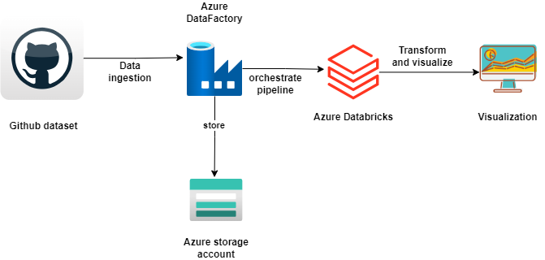
Architecture diagram

Slide 5
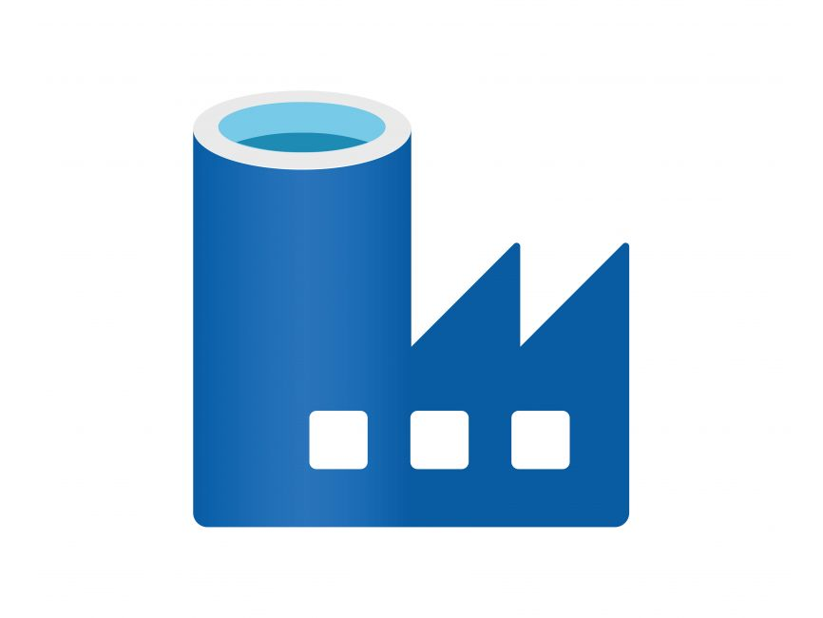


Resources Used for this Project:
Azure Data Factory (ADF):
Azure Blob Storage:
Azure Databricks:

Slide 6
Project Requirements
Data Sources
Azure Data Factory Configuration
Data Movement with Azure Data Factory
Data Storage
Data Processing and visualisation with Azure Databricks

Slide 7
Tasks performed
Acquire data: Retrieve code from a GitHub repository.
Utilize Azure Data Factory (ADF) to orchestrate the transfer of code from GitHub to Azure Blob Storage.
Store data: Utilize Azure Blob Storage to securely store the transferred data.
Process data:Provision an Azure Databricks workspace.
Within ADF, add a Notebook activity: Configure the activity to use your Databricks workspace and specify the PySpark notebook responsible for code analysis Within the PySpark notebook:
Load data from Blob Storage into a Spark DataFrame.
Implement data transformations and analysis using PySpark libraries.
Visualize data: Generate visualizations (e.g., pie charts) depicting the results of code analysis using libraries within Databricks.

Slide 8
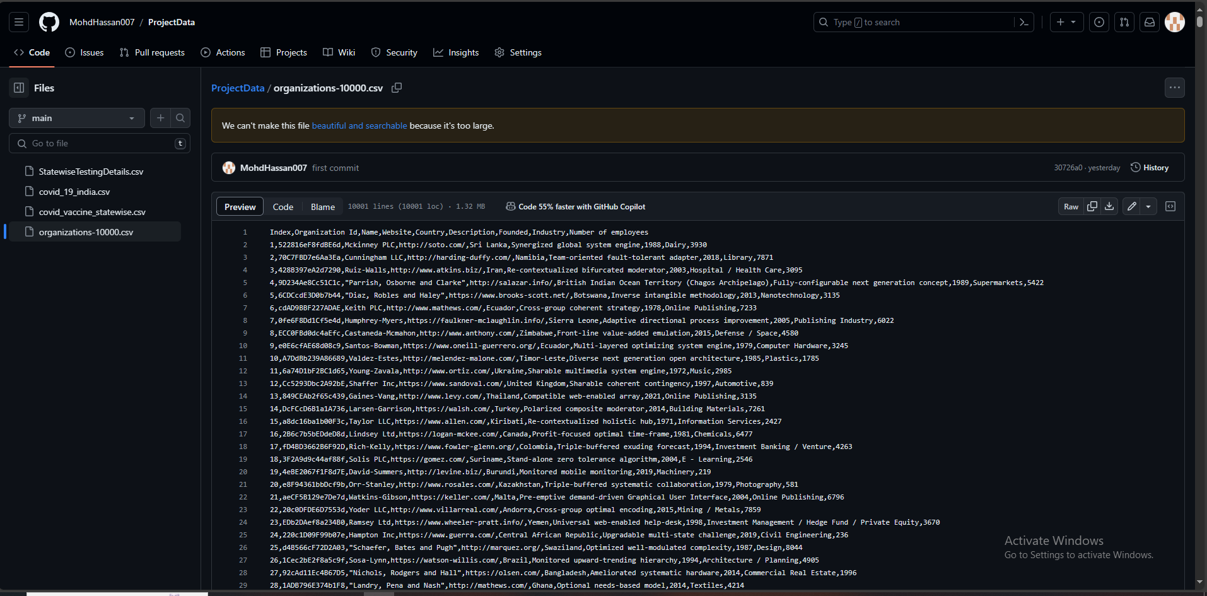
Database in Github

Slide 9
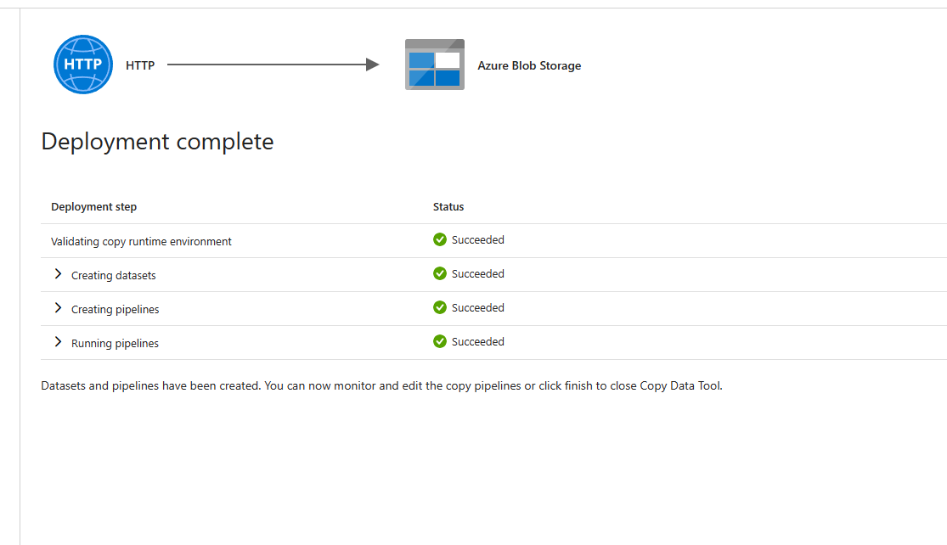
Data transferring in a pipeline

Slide 10
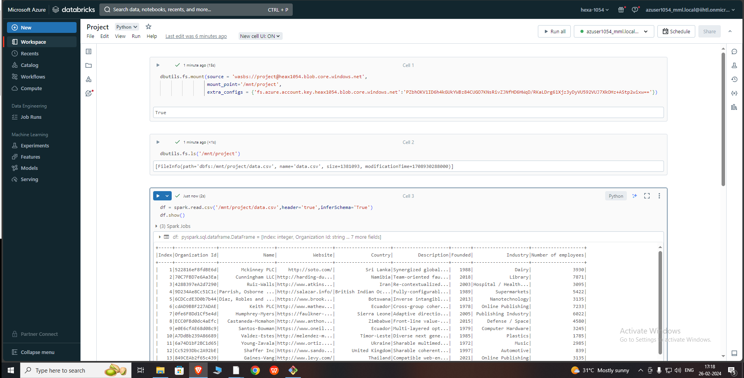
Mounting data from storage account

Slide 11
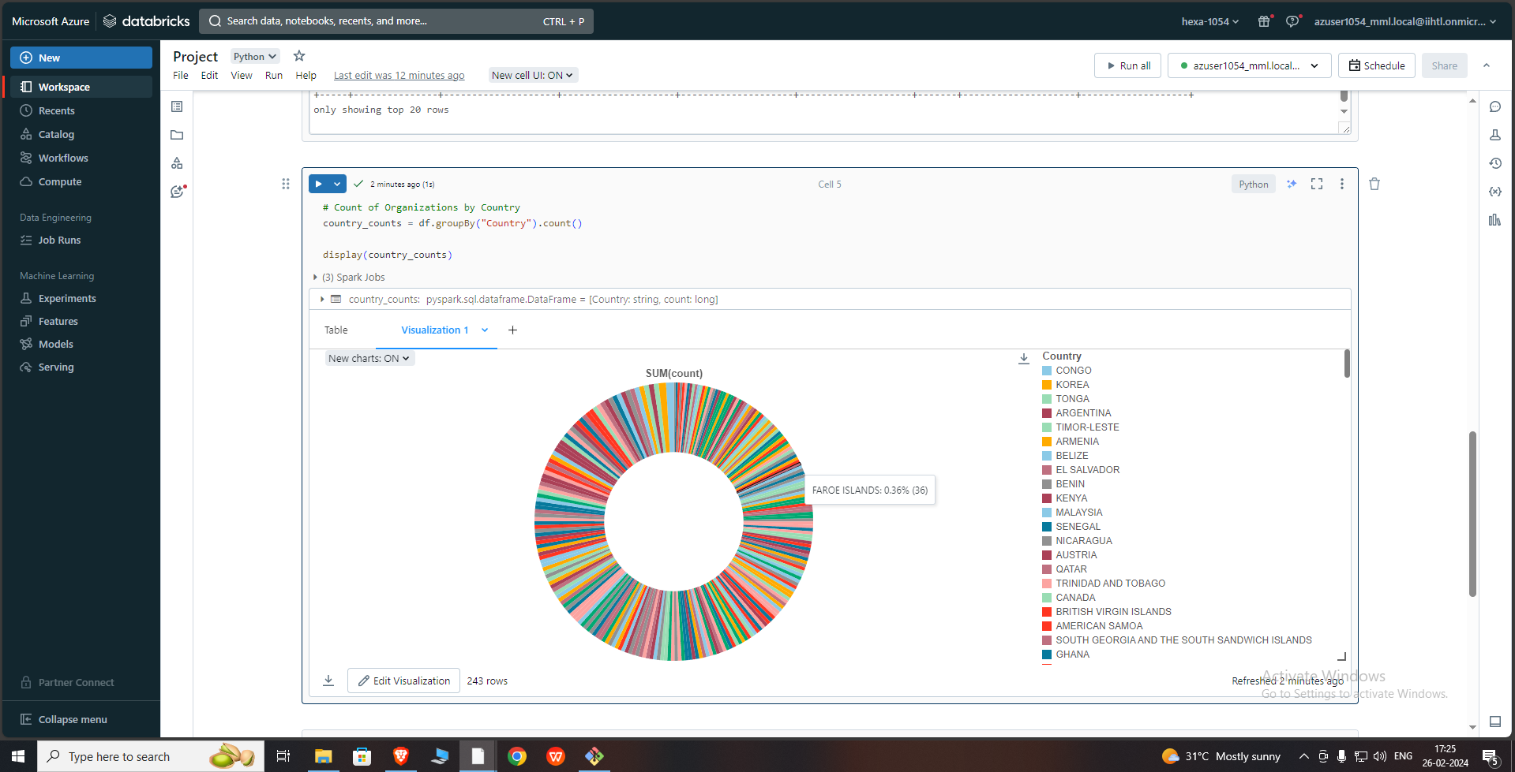
Visualization in databricks

Slide 12
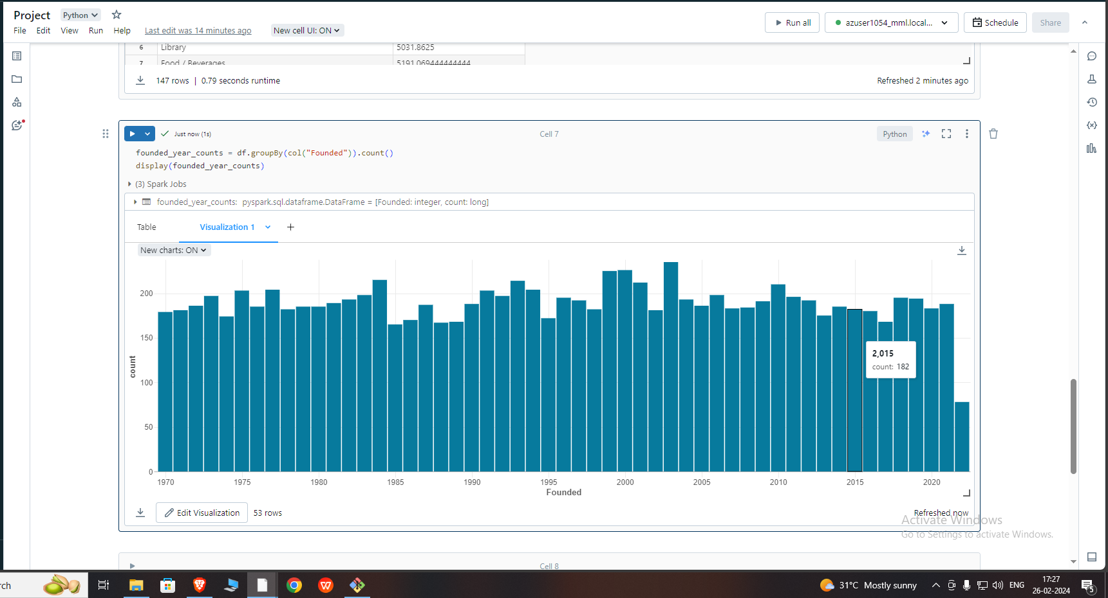
Visualization in databricks

Slide 13
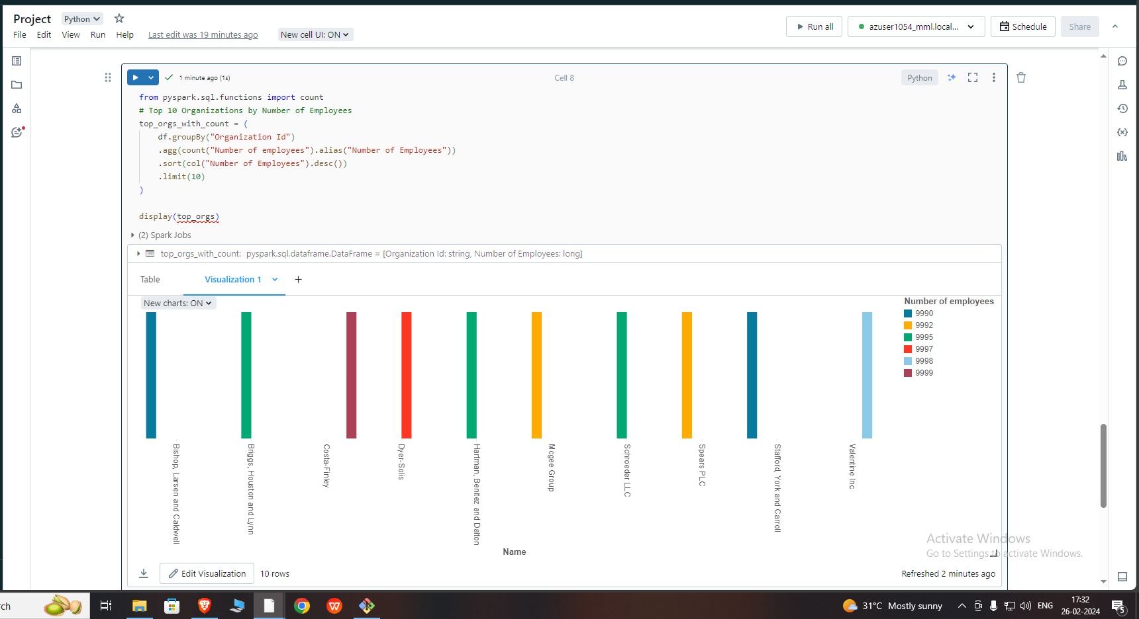
Visualization in databricks

Slide 14
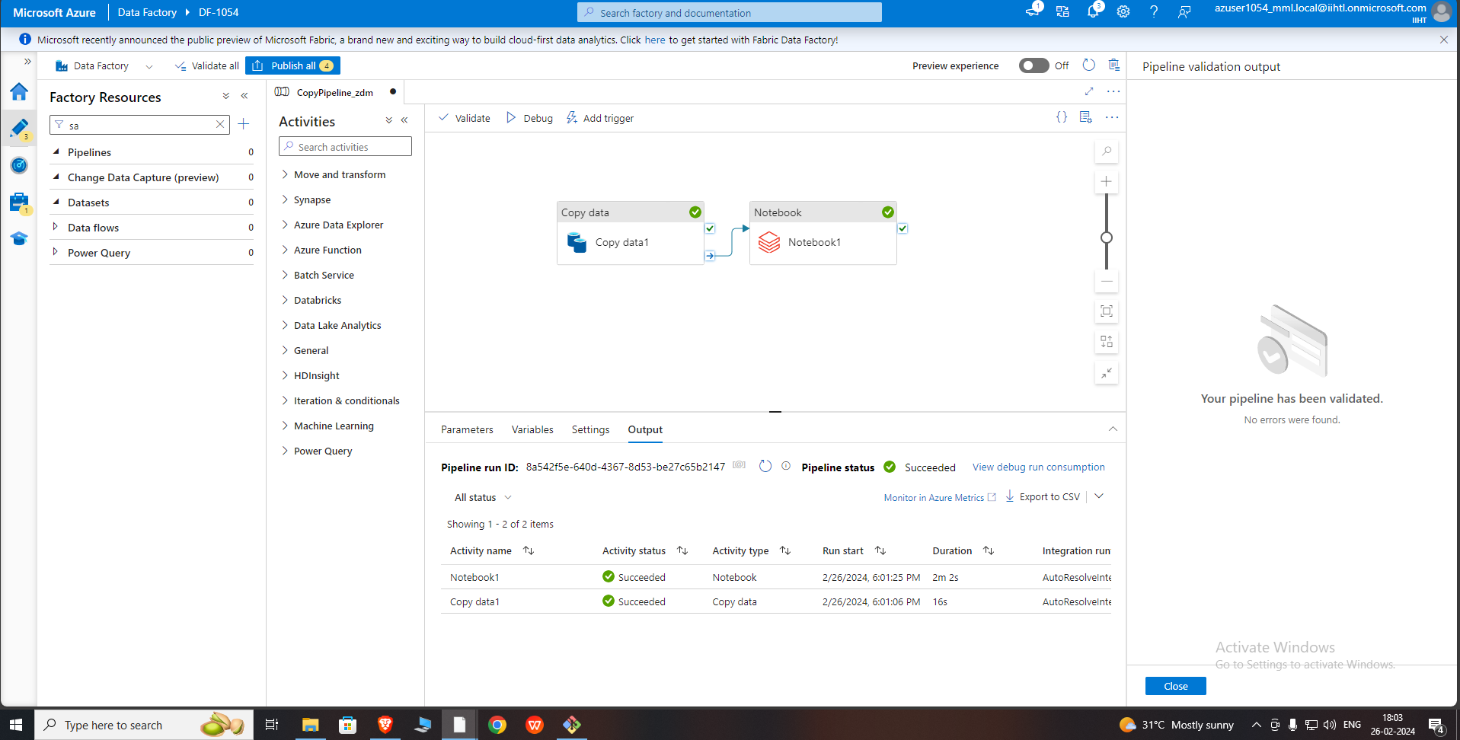
Data pipelines in azure Data factory

Slide 15
Conclusion
In conclusion, this project successfully demonstrated the integration of various Azure services to create an end-to-end data processing pipeline. Beginning with data acquisition from GitHub, we utilized Azure Data Factory to orchestrate data movement to Azure Blob Storage. Subsequently, Azure Databricks was employed for data processing and analysis, including preprocessing tasks and generating insightful visualizations. The seamless integration of these Azure services facilitated efficient data handling and analysis, showcasing the power of cloud-based data solutions in modern data engineering workflows. This project highlights the effectiveness of Azure's ecosystem in enabling scalable and efficient data processing pipelines for diverse use cases.

